Slide 1
Search Algorithms: Object-Oriented Implementation (Part B)
구현 시작!

Slide 2

Contents
Conventional vs. AI Algorithms
Local Search Algorithms
Implementing Hill-Climbing Algorithms
Defining ‘Problem’ Class
Adding Gradient Descent
Defining ‘HillClimbing’ Class
Adding More Algorithms and Classes
Adding Genetic Algorithm
Experiments
앞으로는, Search Algo을 구현하는 과제가 진행되고, 과제에서 구현해야 하는 코드의 일부를 수업시간에 살펴보는 방식으로 진행합니다.

Slide 3
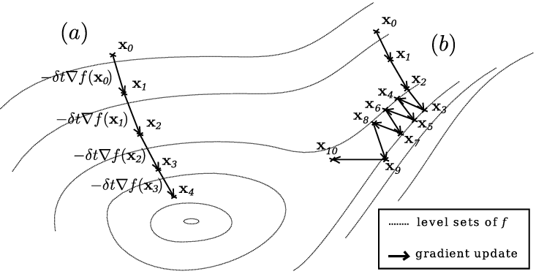
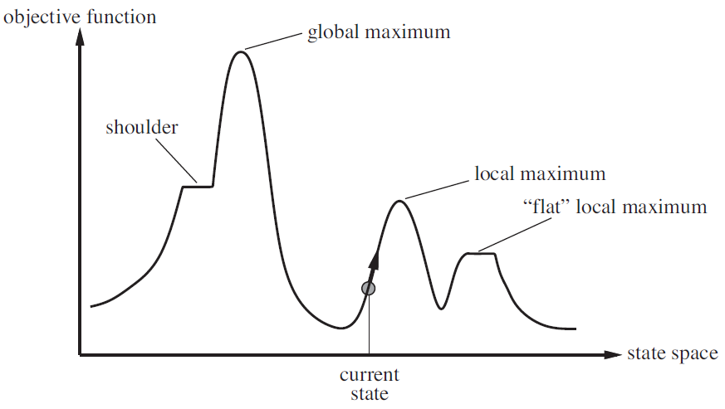
Implementation Reference Notes
Search Algorithm
  The techniques/algorithms covered in the class are methods for iteratively finding the optimal solution, and are called Search Algorithms.
  However, the optimal solution found by the algorithm can be global optimal or local optimal.

Slide 4
Implementation Reference Notes
Search Tool
  In order to execute a Search Algo. (Algorithm), tasks such as problem generation/loading and parameter setting must be performed. // Preprocessing (or 'pre-work')
  Additionally, a function to display the Search Algo. execution results is also necessary. // Post-processing (or 'post-work')
  A program that performs the above steps: 1) Preprocessing, 2) Algorithm execution, and 3) Post-processing is called a Search Tool.

Slide 5
Implementation Reference Notes
Search Tool Version
  The Search Tool is implemented in various versions (iteratively expanded & improved).
    v0 (강의. Search Algo. B) : A version where all the code to implement one algorithm is contained in a single file
    v1 (강의. Search Algo. B) : A version implemented by modularizing the logic common to different pieces of code into a separate file, then importing and using that module/file (code refactoring & reuse)
    v2 (강의. Search Algo. C) : A version implemented using classes (v2.1, v2.2)
    v3~v5 : Versions implemented using classes, with some algorithms added, leading to iterative improvements in the code structure
      v3 : 강의. Search Algo. D
      v4 : 강의. Search Algo. E
      v5 : 강의. Search Algo. F
Today’s

Slide 6
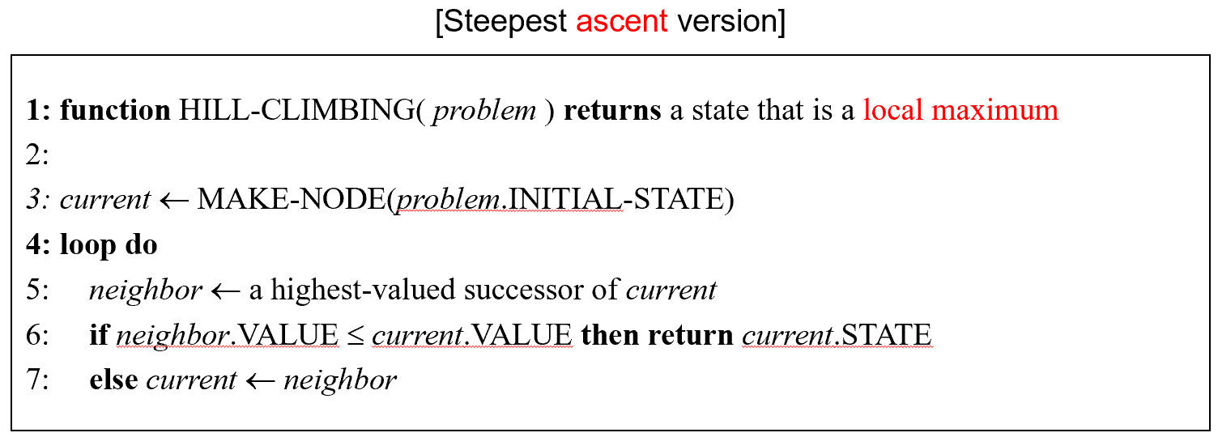

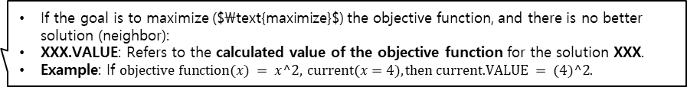
Implementing Hill-Climbing Algorithms
Our eventual goal is to implement an optimization tool that can run various search algorithms
We begin to implement two hill climbing algorithms each for two different types of problems: (we implement a total of four hill climbing algorithms)
  Steepest-ascent hill climbing for numerical optimization (SAHC-N)
  First-choice hill climbing for numerical optimization (FCHC-N)
  Steepest-ascent hill climbing for TSP (SAHC-T)
  First-choice hill climbing for TSP (FCHC-T)
Ref:
numerical optimization : The task of finding the variables that maximize or minimize the objective function/value given a mathematical expression/objective function. // continuous
TSP : The problem of calculating the shortest distance to visit all given cities and return to the starting city. // discrete
복습: Hill Climbing Algo. (왼쪽) vs first-choice hill climbing (오른쪽)
If the goal is to maximize ($\text{maximize}$) the objective function, and there is no better solution (neighbor):
XXX.VALUE: Refers to the calculated value of the objective function for the solution XXX.
Example: If $\text{objective} \text{function}(x) = x^2, \text{current}(x=4), \text{then} \text{current}\text{.}\text{VALUE} = (4)^2.$

Slide 7
Search Tool v0
Today, we’ll only looked at how to implement the two problems of the Numerical Optimization type.
Implementation by including all necessary logic in a single source code file

Slide 8
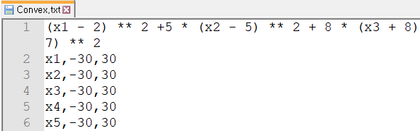
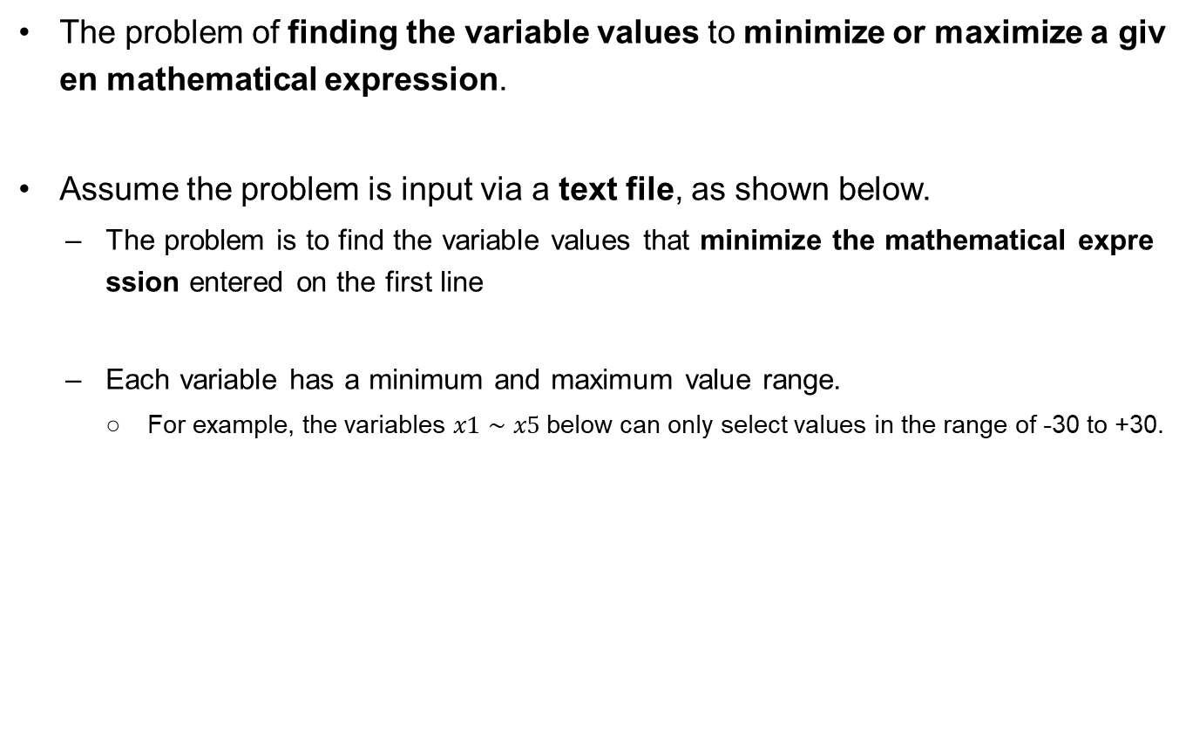
Numerical Optimization
The problem of finding the variable values to minimize or maximize a given mathematical expression.
Assume the problem is input via a text file, as shown below.
  The problem is to find the variable values that minimize the mathematical expression entered on the first line
  Each variable has a minimum and maximum value range.
    For example, the variables $x1∼x5$below can only select values in the range of -30 to +30.
Objective Function
(to minimize)
Variable and Range

Slide 9
Numerical Optimization
Execution Results (Example using the Steepest-Ascent Algorithm)
Input the name and path of the .txt file defining the problem (User Input).
Enter the file name of a function: problem/Convex.txt Objective function: (x1 - 2) ** 2 + 5 * (x2 - 5) ** 2 + 8 * (x3 + 8) ** 2 + 3 * (x4 + 1) ** 2 + 6 * (x5 - 7) ** 2 Search space: x1: (-30.0, 30.0) x2: (-30.0, 30.0) x3: (-30.0, 30.0) x4: (-30.0, 30.0) x5: (-30.0, 30.0) Search algorithm: Steepest-Ascent Hill Climbing Mutation step size: 0.01 Solution found: (1.996, 5.003, -7.997, -1.005, 7.002) Minimum value: 0.000 Total number of evaluations: 95,321
Value goal
* Variable and Range: The value of each variable can be changed within its specified range.
* Problem Goal: Find the $x1, …, x5$ values that make the value of the objective function the smallest.
The calculated optimal solution
The result when the optimal solution is substituted into the objective function.

Slide 10
Numerical Optimization
Execution Results (Example using the First-Choice Algorithm)
Input the name and path of the .txt file defining the problem (User Input).
Enter the file name of a function: problem/Convex.txt Objective function: (x1 - 2) ** 2 + 5 * (x2 - 5) ** 2 + 8 * (x3 + 8) ** 2 + 3 * (x4 + 1) ** 2 + 6 * (x5 - 7) ** 2 Search space: x1: (-30.0, 30.0) x2: (-30.0, 30.0) x3: (-30.0, 30.0) x4: (-30.0, 30.0) x5: (-30.0, 30.0) Search algorithm: First-Choice Hill Climbing Mutation step size: 0.01 Max evaluations with no improvement: 100 iterations Solution found: (2.001, 5.004, -8.003, -1.003, 7.003) Minimum value: 0.000 Total number of evaluations: 37,336
Value goal
* Variable and Range: The value of each variable can be changed within its specified range.
* Problem Goal: Find the $x1, …, x5$ values that make the value of the objective function the smallest.
Main changes
The calculated optimal solution
The result when the optimal solution is substituted into the objective function.

Slide 11
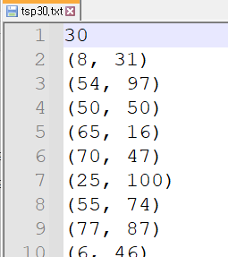
TSP Problem
The problem of planning the route (= order of visits) to visit all cities with the shortest total distance.
Assume the problem is input via a text file, as shown below.
  The number of cities is on the first line.
  The subsequent lines contain the coordinates of each city.
# of cities
City coordinates

Slide 12
TSP Problem
Execution Results (Example using the First-Choice Algorithm)
Input the name and path of the .txt file defining the problem (User Input).
Enter the file name of a TSP: problem/tsp30.txt Number of cities: 30 City locations: (8, 31) (54, 97) (50, 50) (65, 16) (70, 47) (25, 100) (55, 74) (77, 87) (6, 46) (70, 78) (13, 38) (100, 32) (26, 35) (55, 16) (26, 77) (17, 67) (40, 36) (38, 27) (33, 2) (48, 9) (62, 20) (17, 92) (30, 2) (80, 75) (32, 36) (43, 79) (57, 49) (18, 24) (96, 76) (81, 39) Search algorithm: First-Choice Hill Climbing Max evaluations with no improvement: 100 iterations Best order of visits: 4 26 2 24 16 27 0 8 10 12 17 18 22 19 3 13 20 29 11 28 23 7 9 6 25 1 14 15 21 5 Minimum tour cost: 491 Total number of evaluations: 677
City starts from index 0...
The last city is City 29
The Optimal Order of Visits
The Total Distance traveled when following the optimal route.

Slide 13
TSP Problem
Execution Results (Example using the Steepest-Ascent Algorithm)
Input the name and path of the .txt file defining the problem (User Input).
Enter the file name of a TSP: problem/tsp30.txt Number of cities: 30 City locations: (8, 31) (54, 97) (50, 50) (65, 16) (70, 47) (25, 100) (55, 74) (77, 87) (6, 46) (70, 78) (13, 38) (100, 32) (26, 35) (55, 16) (26, 77) (17, 67) (40, 36) (38, 27) (33, 2) (48, 9) (62, 20) (17, 92) (30, 2) (80, 75) (32, 36) (43, 79) (57, 49) (18, 24) (96, 76) (81, 39) Search algorithm: Steepest-Ascent Hill Climbing Best order of visits: 11 29 20 13 3 4 28 23 9 1 7 6 2 16 26 25 21 5 8 15 14 10 0 12 27 24 17 19 18 22 Minimum tour cost: 620 Total number of evaluations: 807
The Optimal Order of Visits
The Total Distance traveled when following the optimal route.

Slide 14
Steepest-Ascent Hill Climbing for Numerical Optimization
main():
  Creates a problem instance by reading a function expression and its domain information from the file given by the user (createProblem)
    Returns : p = (expr, domain)
    expr : Objective Function
    domain : minimization/maximization
  Calls the search algorithm (steepestAscent) and obtains the results
  Shows the specifics of the problem just solved (describeProblem)
  Shows the settings of the search algorithm (displaySettings)
  Reports the results (displayResults)

Slide 15
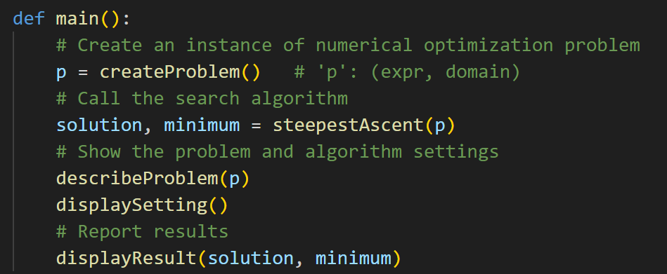
Steepest-Ascent Hill Climbing for Numerical Optimization
main():
  Creates a problem instance (createProblem)
  Calls the search algorithm (steepestAscent) and obtains the results
  Shows the specifics of the problem just solved (describeProblem)
  Shows the settings of the search algorithm (displaySettings)
  Reports the results (displayResults)

Slide 16
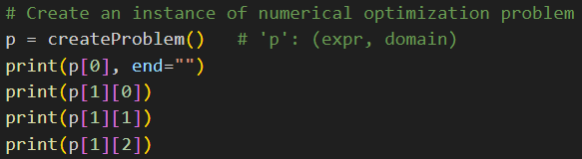
Steepest-Ascent Hill Climbing for Numerical Optimization
createProblem():
  Gets a file name from the user and reads information from the file
    Function expression – saved as a string # problem instance
    Variable names – saved as a list of strings
    Lower bounds of the variables – saved as a list of floats
    Upper bounds of the variables – saved as a list of floats
  Returns the problem instance as a list of expression and domain, where the domain is a list of the followings :
    Variable names
    Lower bounds
    Upper bounds
the problem to be solved
# domain
Prints createProblem return value (=problem instance)
Enter the file name of a function: problem/Convex.txt (x1 - 2) ** 2 + 5 * (x2 - 5) ** 2 + 8 * (x3 + 8) ** 2 + 3 * (x4 + 1) ** 2 + 6 * (x5 - 7) ** 2 [‘x1’, ‘x2’, ‘x3’, ‘x4’, ‘x5’] # var [-30.0, -30.0, -30.0, -30.0, -30.0] # lower [ 30.0, 30.0, 30.0, 30.0, 30.0] # upper

Slide 17
Steepest-Ascent Hill Climbing for Numerical Optimization
steepestAscent(p):
  Given a problem p, takes a random initial point (randomInit) as a current point and evaluates it (evaluate)
  Repeats updating the current point:
    Generate multiple neighbors (mutants)
    Finds the best one (bestOf) among them
    If it is better than current, update and continue
    Otherwise, stop
  Returns the final current point and its evaluation value
“neighbor” = Solution adjacent to current
Adjacent solution = Solution obtained by slightly changing current solution

Slide 18
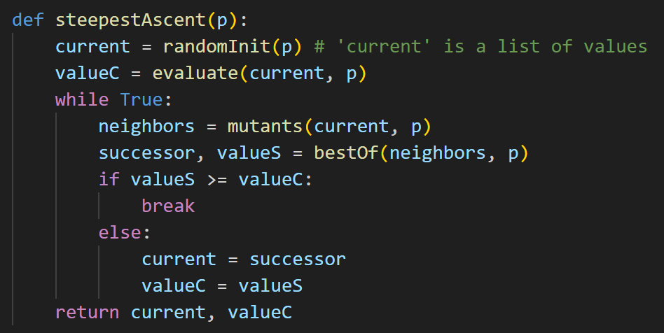
Steepest-Ascent Hill Climbing for Numerical Optimization
steepestAscent(p):

Slide 19
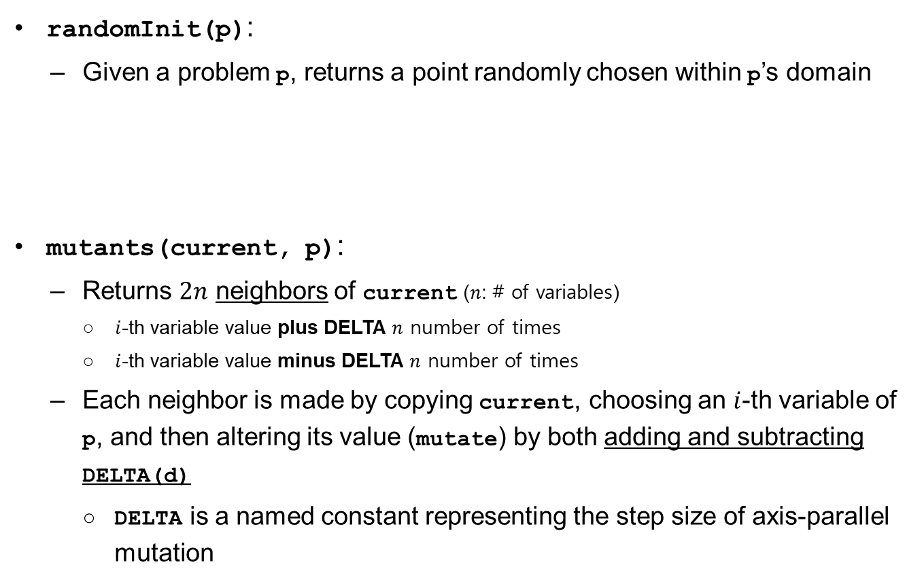
Steepest-Ascent Hill Climbing for Numerical Optimization
randomInit(p):
  Given a problem p, returns a point randomly chosen within p’s domain
mutants(current, p):
  Returns $2n$ neighbors of current ($n$: # of variables)
    $i$-th variable value plus DELTA $n$ number of times
    $i$-th variable value minus DELTA $n$ number of times
  Each neighbor is made by copying current, choosing an $i$-th variable of p, and then altering its value (mutate) by both adding and subtracting DELTA(d)
    DELTA is a named constant representing the step size of axis-parallel mutation
Generates a solution (point) randomly within the range that satisfies the specified minimum ($\text{lower} \text{bound}$) and maximum ($\text{upper} \text{bound}$) conditions.
One of the methods for generating the adjacent ($\text{neighboring}$) successors of $\text{current}$

Slide 20
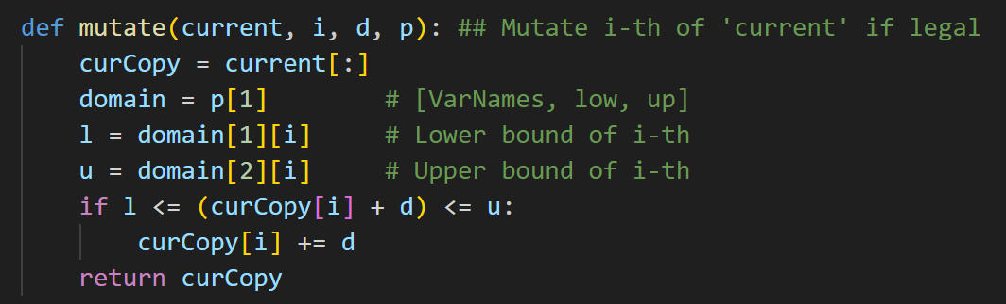

Steepest-Ascent Hill Climbing for Numerical Optimization
mutate(current, i, d, p):
  Makes a copy of current, alter the value of $i$-th variable by adding d as long as the new value remains within the domain of p, and returns the resulting mutant

Slide 21
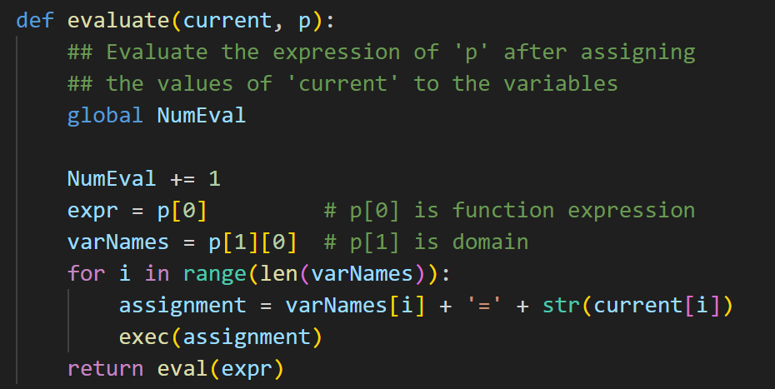
Steepest-Ascent Hill Climbing for Numerical Optimization
evaluate(current, p):
  Evaluates the expression of problem p after assigning the values of current to its variables, and returns the result
    Global variable NumEval is used to count the number of evaluations

Slide 22
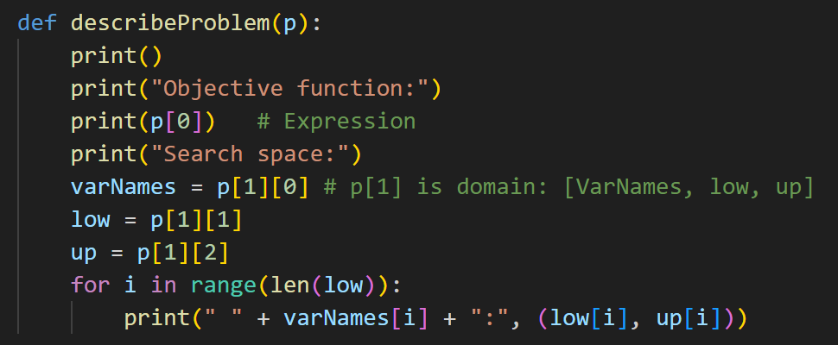
Steepest-Ascent Hill Climbing for Numerical Optimization
bestOf(neighbors, p):
  Evaluates each candidate solution in neighbors (evaluate), identifies the best one, and returns it with its evaluation value
describeProblem(p):
  Shows the expression and the domain of problem p

Slide 23
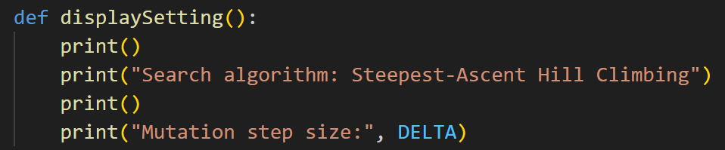
Steepest-Ascent Hill Climbing for Numerical Optimization
desplaySetting():
  Shows that the steepest-ascent hill climbing has been used as the search algorithm
  Displays the step size (DELTA) of the axis-parallel mutation

Slide 24
Steepest-Ascent Hill Climbing for Numerical Optimization
displayResult(solution, minimum):
  Reports the result of optimization, which consists of
    solution (the best solution found),
    minimum (its evaluation value), and
    the total number of evaluations
  solution is transformed to a tuple (coordinate) before printing
coordinate(solution):
  Rounds up solution and returns it (to the third decimal place)

Slide 25
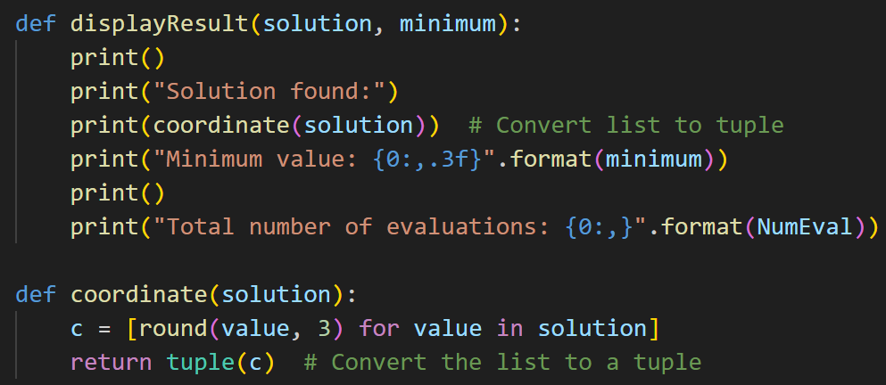
Steepest-Ascent Hill Climbing for Numerical Optimization
displayResult(solution, minimum):
coordinate(solution):

Slide 26

Steepest-Ascent Hill Climbing for Numerical Optimization
The program is required to import ‘random.py’ and ‘math.py’

Slide 27

First-Choice Hill Climbing for Numerical Optimization
Algorithm change
main():
  The only difference is that it calls firstChoice instead of steepestAscent

Slide 28
First-Choice Hill Climbing for Numerical Optimization
firstChoice(p):
  Only one random successor is generated (randomMutant) to update the current solution
  The algorithm stops if no improvement is observed for a certain consecutive number (LIMIT_STUCK) of iterations assuming that the search is stuck at a local minimum
    LIMIT_STUCK is a named constant in this implementation
Unlike the method of generating multiple neighbor $\text{soln}$ and selecting the best among them, only one random neighbor $\text{soln}$ is selected.
If a worse solution appears consecutively for the number of LIMIT_STUCK iterations, the program stops.
We assume LIMIT_STUCK = 100

Slide 29
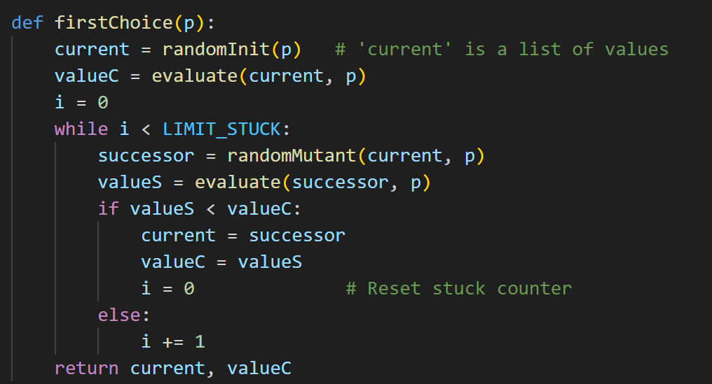
First-Choice Hill Climbing for Numerical Optimization
firstChoice(p):

Slide 30
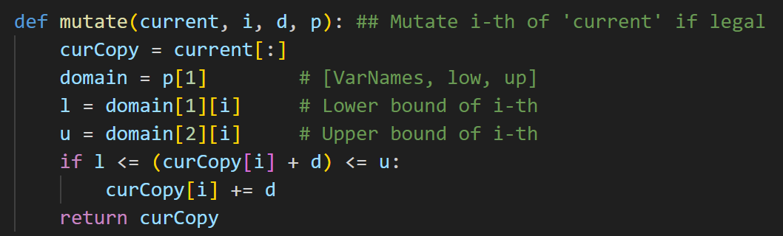

First-Choice Hill Climbing for Numerical Optimization
randomMutant(current, p):
  Returns a mutant of current, which is made by randomly choosing a variable of p and then altering its value (mutate) by either adding or subtracting DELTA
  The randomMutant function is implemented by calling the mutate function. When doing so, it must decide which index's stored value to modify ($\text{d}=\text{DELTA}=0.01$).

Slide 31
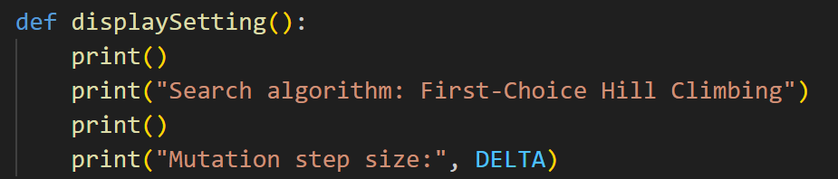
First-Choice Hill Climbing for Numerical Optimization
displaySetting():
  Shows that the search algorithm used is first-choice hill climbing
The functions createProblem, randomInit, evaluate, mutate, describeProblem, displayResult, and coordinate are all reused without change

Slide 32
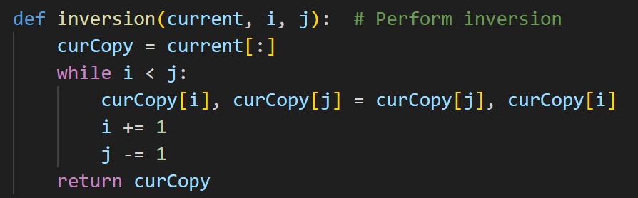
Hill Climbing for TSP (외판원 문제)
For TSP, the structure of the problem and its implementation are nearly identical to the NumericalOptimization problem
  However, the logic for generating mutant are different
  TSP generate the mutant (adjacent solution) using mutate by inversion (refer to the previous lecture)
inversion : Generating one adjacent solution
  Reverese the items from index i to index j
The TSP implementation will be examined in detail in the next lecture.

Slide 33
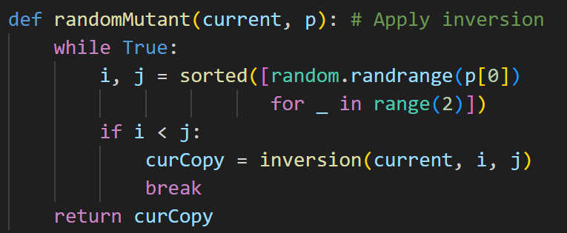
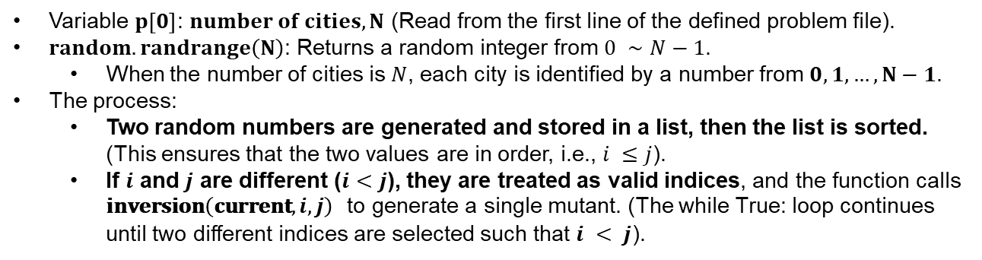
Hill Climbing for TSP (외판원 문제)
First-Choice (TSP) : generating a single mutant
Variable $p\left[0\right]$: $\text{number} \text{of} \text{cities},N$ (Read from the first line of the defined problem file).
$random.randrange\left(N\right)$: Returns a random integer from $0 ∼N−1$.
  When the number of cities is $N$, each city is identified by a number from $0,1,…,N−1$.
The process:
  Two random numbers are generated and stored in a list, then the list is sorted. (This ensures that the two values are in order, i.e., $i ≤j$).
  If $i$ and $j$ are different ($i<j$), they are treated as valid indices, and the function calls $\text{inversion}\left(\text{current},i,j\right)$ to generate a single mutant. (The while True: loop continues until two different indices are selected such that $i < j$).

Slide 34
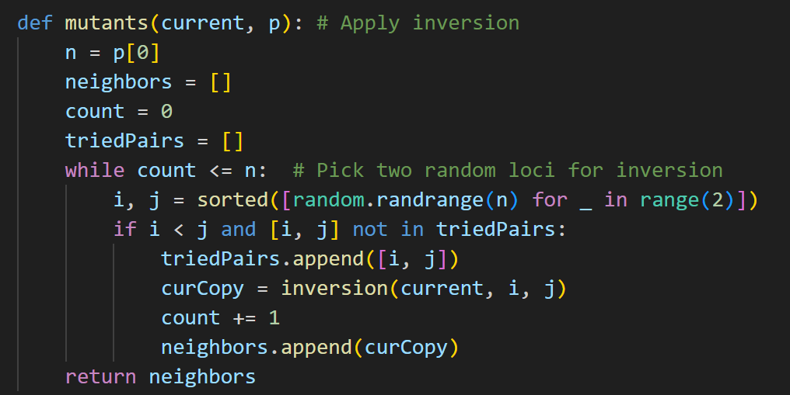
Hill Climbing for TSP (외판원 문제)
Steepest-Ascent (TSP) : Create a number of mutants

Slide 35
Code
Ref:
  The code omitted from the lecture materials must be implemented in the homework.
That's all for today's lecture!

